Slide 1

Salary Analysis
Ruby Delacruz

Slide 2
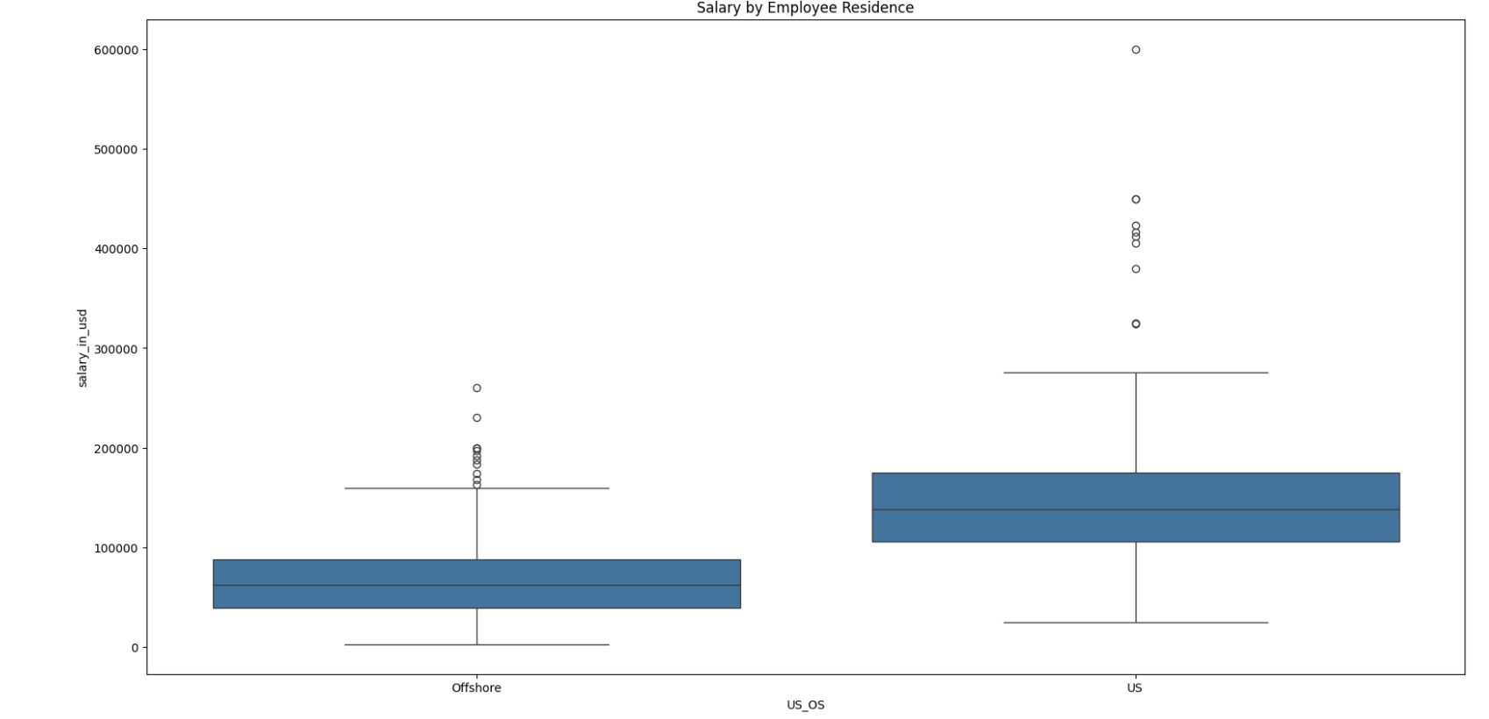
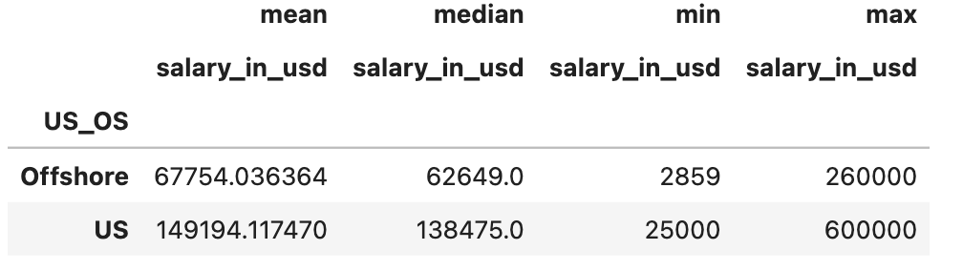
Salary range
The average salary of data science roles in the US is about $149k while the average salary offshore is $67k.
Notes:
This first slide shows the salary range of data science jobs by employee residence. The pivot table shows mean, median, min and max salary in USD for both offshore and US employee residences. Employee residence is a better indicator to get an idea of what the regions are paying in data science roles. The box plot shows the data in the pivot table showing us the IQR and outliers of salary in USD by US. There seems to be no significant skew showing salaries seem to be both evenly distributed by US and offshore. The boxplot also shows a significant amount of outliers closer to the data set for offshore while the one’s for the US are a bit farther from the data set. This can cause a skew to the right but it is not significant.

Slide 3
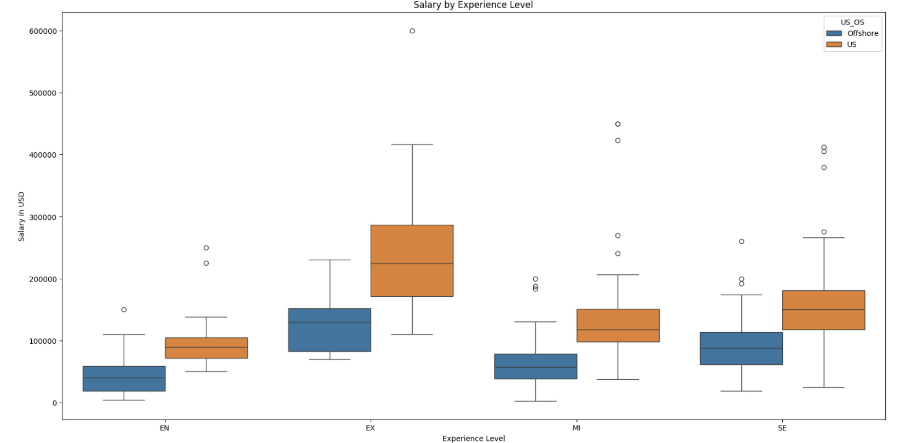
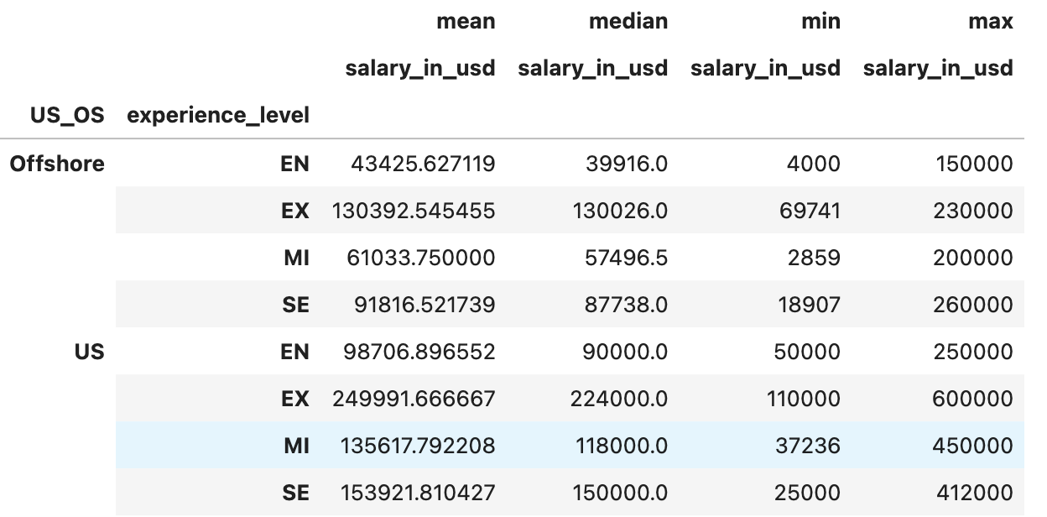
Experience VS SAlary
Experience has an impact on salary. This is consistent in US and Offshore.
Hiring a senior or executive role in data science could cost around $153k - $249k in the US. Offshore this could range from $91k – $130k.
Notes:
The pivot table on this slide shows mean, median, min and max of each experience level by employee residence in the US or offshore. From the boxplot we can visibly tell that for each role the US pays more than offshore. Experience has a direct effect in salary you can tell by looking at the experience levels in the boxplot and seeing how our box goes up as the experience level increases.

Slide 4
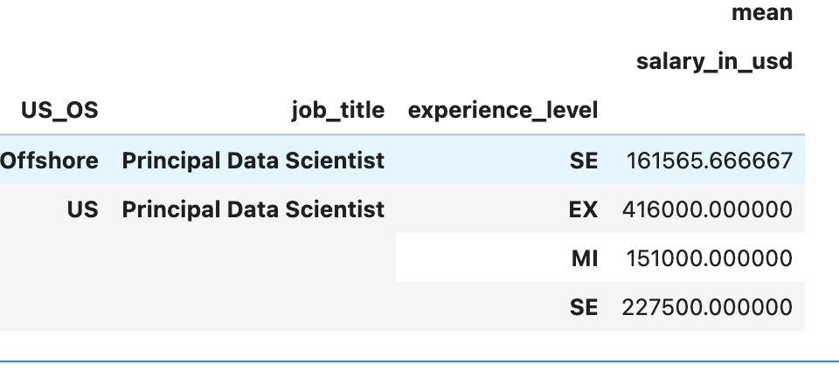
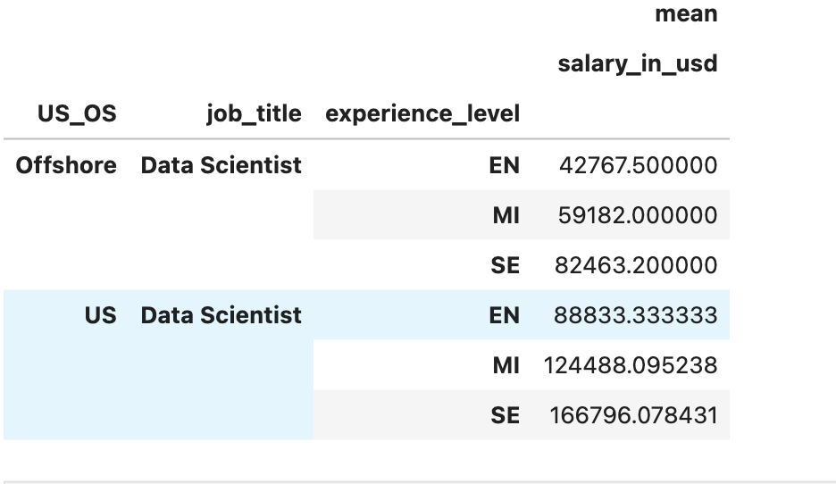
Recommendation
I recommend we hire a Senior Data Scientist to get the team started. We can pay them a salary of $167,000 which seems suitable to his experience.
Notes:
Based off my analysis it is best to hire a senior level data science who has experience but is not an executive. The mean salary for this role is $167k. This seems reasonable considering the experience and the possibility that they could be leading a team at some point.

